Slide 1

Team MedBridge
Presents An App for Medication Gap.
Sumanth
Sayali
Huong

Slide 2

We Found a Problem!!!
Time cue
Interactions to avoid
Dosage missing
Refilling statuses
Possible side effects
Family Caregivers' comprehensive tool to manage medication
Notes:
A study published in 2022 by Innovations in Pharmacy highlights that 29% caregivers experienced anxieties about making medication mistakes, such as administering medication at the wrong time, missing doses. Additionally, 92.3% of caregivers in another research identified at least one gap in their medication knowledge for the care recipients. Source: https://pmc.ncbi.nlm.nih.gov/articles/PMC9598962/#B1

Slide 3
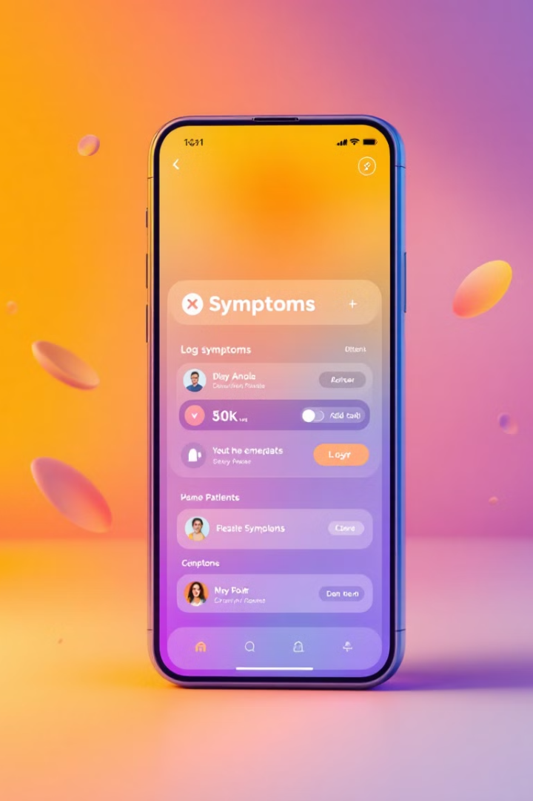
An App for Medication Gap
An app bridges the gap between Doctors and Patients in making medication administering easily manageable.

Slide 4
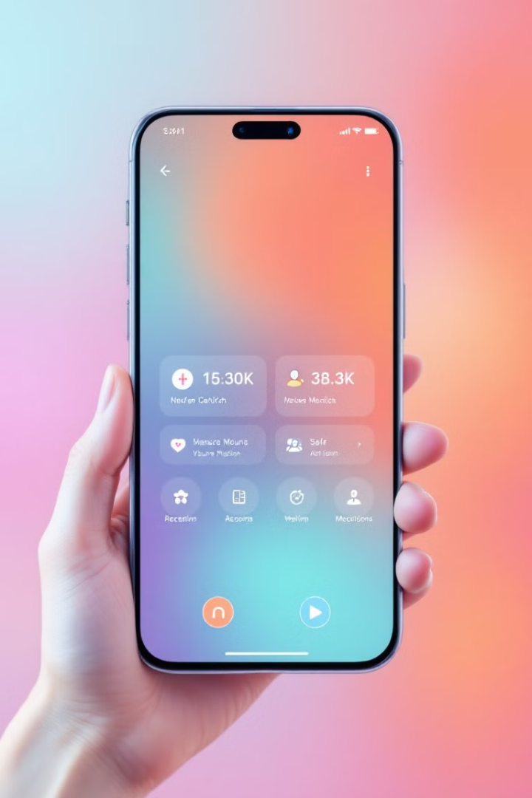
Introducing Our MedBridge App
Our innovative medication app is transforming the patient experience. Designed with your privacy in mind, it seamlessly integrates timely reminders, side effects info and emergency protocols to take control of your health.
Notes:
Our MedBridge app prioritizes patient benefits, ensuring that all caregiver challenges are fully addressed while maintaining complete peace of mind regarding privacy.

Slide 5
Also,
information about your prescriptions, dosages, dates filled, and prescribers can reveal a lot about your medical history.
In 2009, the Federal Trade Commission (FTC) fined CVS Health for throwing pill bottles into open dumpsters with patient names, addresses, prescribing physicians’ names, medication and dosages, along with medication instruction sheets with personal information.
Notes:
The 2009 incident with CVS Health, where patient information was improperly discarded, highlights why we are truly committed to protecting privacy.

Slide 6

Revolutionizing the Patient Privacy.
Prescription and personal details
Validated by Doctors
Seamless Integration
Medication schedule and dosage being verified by doctors' office
Seamlessly connects all aspects of your healthcare, privacy, family health management and puts you in control.
Completely handled & managed by patients.
Notes:
From doctors to patients, privacy is fully secured, with all prescription details and patient information integrated and verified throughout the process.

Slide 7

Three main aspects of MedBridge.
1
Manage.
As a responsible person easily manage health of elderly people and children/infants.
2
Set Reminders & Emergency protocols
Easily set schedule and reminders for you and your family members. Receive emergency protocols and side effect info, all in one place.
3
Access to Caregivers
Providing limited access to caregivers for looking after elderly people.

Slide 8
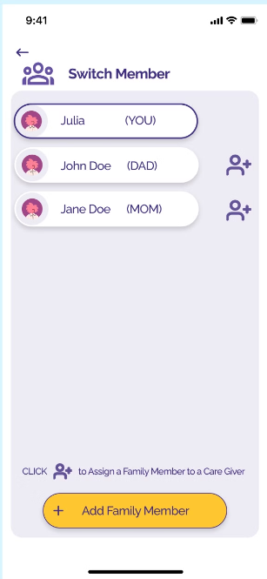
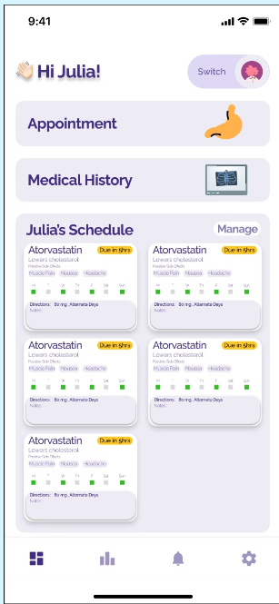
Manage and Track health of your loved ones.
User can switch members to have a look for each elderly member, personalized dashboards and timely reminders with Special notes besides.

Slide 9

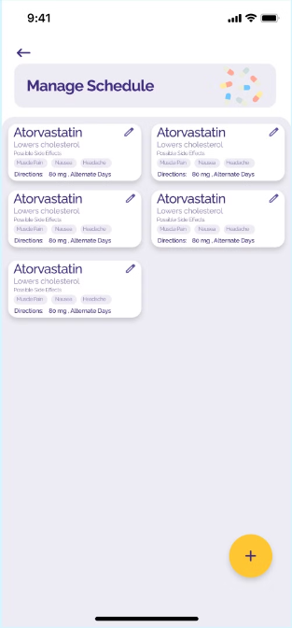
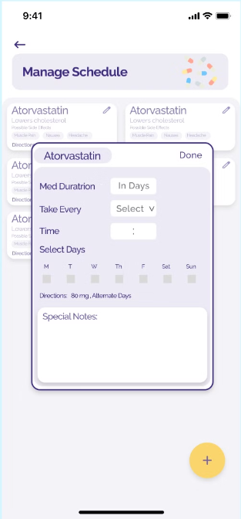
Schedule Management.
The person has to input correct timings and drug names suggested by the doctors so, that he/she can be timely reminded about the medication.

Slide 10
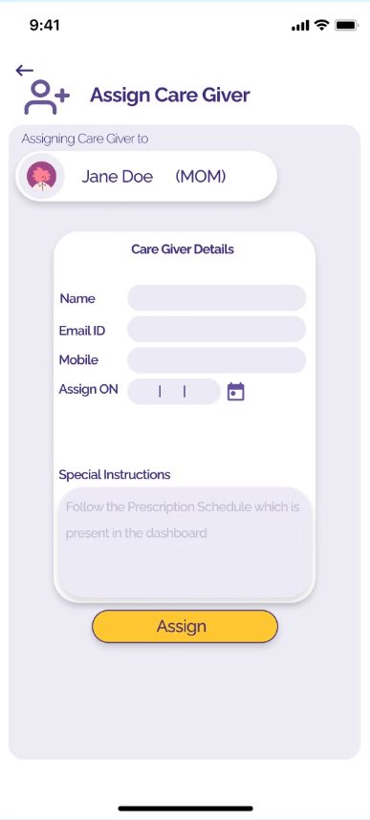
Limited Access for Caregivers.
Elderly people are not tech savvy, they need constant help of somebody, in this case a responsible person from family can look after their parents or hire a caregiver, and provide them limited access.

Slide 11
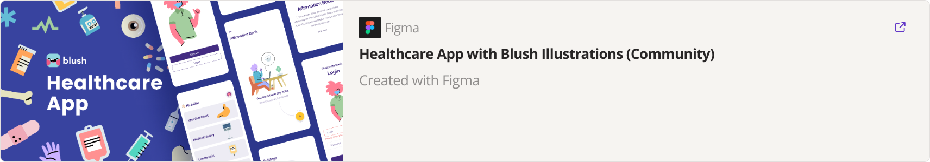
The Demo

Slide 12

Thankyou!
Questions?

